Slide 1


JUNIT

Slide 2


HISTORY
• Kent Beck developed the first xUnit automated test tool for Smalltalk in mid-90’s
• Beck and Gamma (of design patterns Gang of Four) developed JUnit on a flight from Zurich to Washington, D.C.
• Martin Fowler: “Never in the field of software development was so much owed by so many to so few lines of code.”
• Junit has become the standard tool for Test-Driven Development in Java
• Junit test generators now part of many Java IDEs (Eclipse, BlueJ, Jbuilder, DrJava)
• Xunit tools have since been developed for many other languages (Perl, C++, Python, Visual Basic, C#, …)

Slide 3

UNIT TESTING
• Unit Testing is one of the phase of software development process in which units(smallest part of the application) are separately examined for proper operation.
• Generally programmers and occasionally white box testers created unit tests.
• Its implementation can vary from being very manual (pencil and paper) to being formalized as part of build automation.

Slide 4
TESTS THAT ARE PERFORMED DURING THE UNIT
TESTING ARE EXPLAINED BELOW
• Module Interface test: In module interface test, it is checked whether the information is properly flowing in to the program unit (or module) and properly happen out of it or not.
• Local data structures: These are tested to inquiry if the local data within the module is stored properly or not.
• Boundary conditions: It is observed that much software often fails at boundary related conditions. That’s why boundary related conditions are always tested to make safe that the program is properly working at its boundary condition’s.
• Independent paths: All independent paths are tested to see that they are properly executing their task and terminating at the end of the program.
• Error handling paths: These are tested to review if errors are handled properly by them or not.

Slide 5
FAMOUS JAVA UNIT TESTING TOOLS
• JMockit
• Artima SuiteRunner
• Cactus
• Checkstyle
• Cobertura
• Continuous Testing
• Daedalos JUnit Extensions
• Dbunit
• DDSteps
• DepUnit
• djUnit
• Dumbster
• EasyMock + ClassExtension
• EclEmma
• Ejb3unit
• Emma
• Feed4JUnit
• Fest
• Findbugs
• Gretel
• GroboUtils
• Hansel 1.0
• Haste
• J2ME Unit Testing Toolkit
• Jacareto
• Jete
• Jetif
• JFCUnit
• Jiffie
• jMock
• JOSIT
• JsTester
• JSystem

Slide 6
FAMOUS JAVA UNIT TESTING TOOLS
• JUnitPerf
• JXUnit
• Macker
• Mockito
• MockObjects
• Mockrunner
• MoMEUnit
• moreUnit
• NoUnit
• Pisces
• PMD
• Quilt
• Slim
• Sonar
• StrutsTestCase for JUnit v1.9.5
• T2
• TagUnit
• Testare
• TestGen4J
• TestNG
• UISpec4J
• Unitils
• XHTMLUnit
• Xtest
• Fest
• Findbugs
• Gretel
• GroboUtils
• Hansel 1.0
• Haste
• J2ME Unit Testing Toolkit
• Jailer
• JDepend
• JEasyTest
• JellyUnit
• Jester
• JTestCase
• Jumble
• JUnit
• JUnit-addons
• JUnitDoclet
• JUnitEE

Slide 7
JUNIT
• It is part of unit testing frameworks family collectively known as xUnit. Other examples are CPPUnit, PHPUnit, JSUnit etc.
• JUnit is linked as a JAR at compile-time; the framework resides under packagesjunit.framework for JUnit 3.8 and earlier and under org.junit for JUnit 4 and later.
• JUnit has now become the standard tool for Test-Driven Development in Java.
• JUnit test generators now part of many Java IDEs (Eclipse, BlueJ, Jbuilder, DrJava etc).

Slide 8
JUNIT(CONTD…)
• JUnit provides Annotation to identify the test methods and utility methods to assert expected results.
• JUnit has Test runners for running tests.
• JUnit tests can be organized into test suites which contains test cases and other test suites.
• JUnit Framework can be easily integrated with either of the followings:
• Eclipse
• Ant
• Maven

Slide 9
TESTING VIA JUNIT
• Can test JUnit by using Test Case & Test Suit .
• Test Case: A Test Case is a java class which is used to test a single class.
• Test Suite :A Test Suit is a java class which contains many test cases or java classes to test together in a single run.

Slide 10
BENEFITS
• Simple framework for writing automated, self-verifying tests in Java
• Support for test assertions
• Test suite development
• Immediate test reporting

Slide 11
FEATURES
• Annotation to identify the test methods(After JUnit 4 ).
• Assertions for testing expected results.
• Test fixtures for sharing common test data.
• Test runners for running tests.
• Aggregating tests using suites.

Slide 12
NEED OF JUNIT
• JUnit tests allow you to write code faster while increasing quality.
• JUnit is elegantly simple. It is less complex & takes less time.
• JUnit tests can be run automatically and they check their own results and provide immediate feedback. There's no need to manually comb through a report of test results.
• JUnit tests can be organized into test suites containing test cases and even other test suites.
• Writing JUnit tests is inexpensive.

Slide 13
JUNIT ANNOTATIONS
• @Test : The Test annotation tells JUnit that the public void method to which it is attached can be run as a test case.
• @Before : Several tests need similar objects created before they can run. Annotating a public void method with @Before causes that method to be run before each Test method.
• @After : If you allocate external resources in a Before method you need to release them after the test runs. Annotating a public void method with @After causes that method to be run after the Test method.
• @BeforeClass : Annotating a public static void method with @BeforeClass causes it to be run once before any of the test methods in the class. This can be used to perform computationally expensive setup (like logging into a database).
• @AfterClass : Will perform the method after all tests have finished. This can be used to perform clean- up activities for example be used to disconnect to a database
• @Ignore : Sometimes you want to temporarily disable a test or a group of tests. Methods annotated with Test that are also annotated with @Ignore will not be executed as tests. Also, you can annotate a class containing test methods with @Ignore and none of the containing tests will be executed.

Slide 14
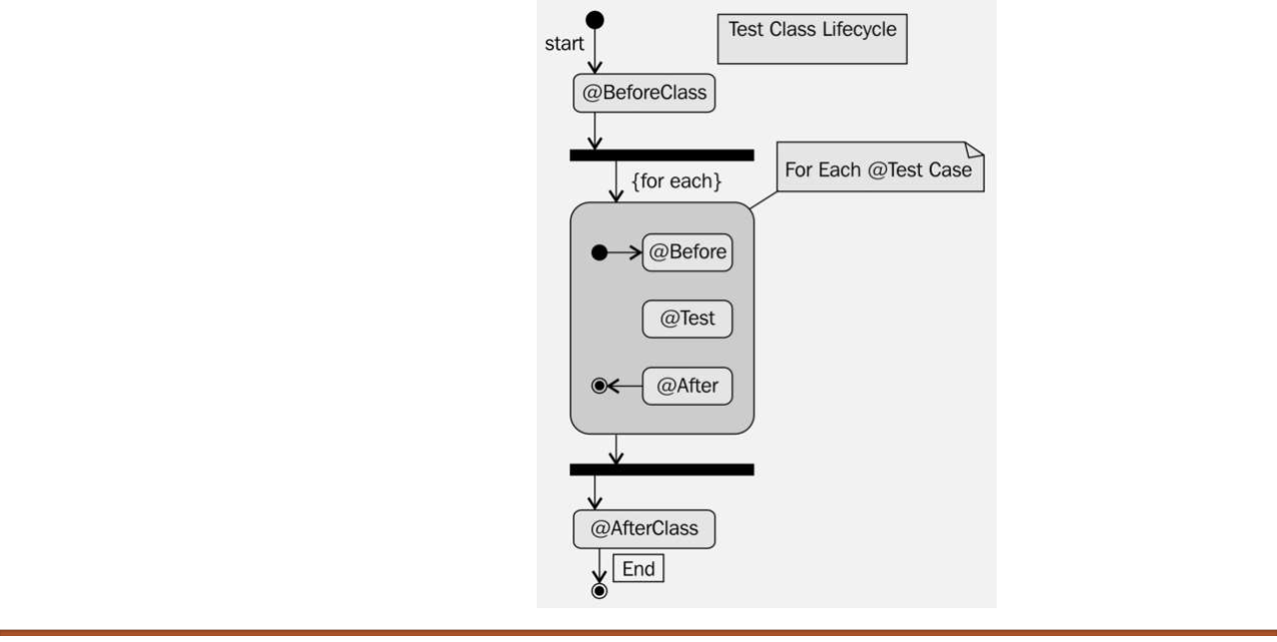

JUNIT LIFE CYCLE

Slide 15
ASSERTION
• All the assertion are in the Assert class.
public class Assert extends java.lang.Object
• This class provides a set of assertion methods useful for writing tests.
• Only failed assertions are recorded.

Slide 16
ASSERTION METHODS
• void assertEquals(boolean expected, boolean actual) Check that two primitives/Objects are equal
• void assertTrue(boolean expected, boolean actual) Check that a condition is true
• void assertFalse(boolean condition) Check that a condition is false
• void assertNotNull(Object object) Check that an object isn't null.
• void assertNull(Object object) Check that an object is null

Slide 17
ASSERTION METHODS(CONTD…)
• void assertSame(boolean condition) The assertSame() methods tests if two object references point to the same object
• void assertNotSame(boolean condition) The assertNotSame() methods tests if two object references not point to the same object
• void assertArrayEquals(expectedArray, resultArray); The assertArrayEquals() method will test whether two arrays are equal to each other.
• fail(String message) Fails a test with the given message.
• assertArrayEquals(String message,expected array,actual array) Asserts that two byte arrays are equal. If they are not, an AssertionError is thrown with the given message.

Slide 18

JUNIT SET UP
• download the latest version of JUnit, referred asjunit4.x.x.zipfrom given below link :

Slide 19
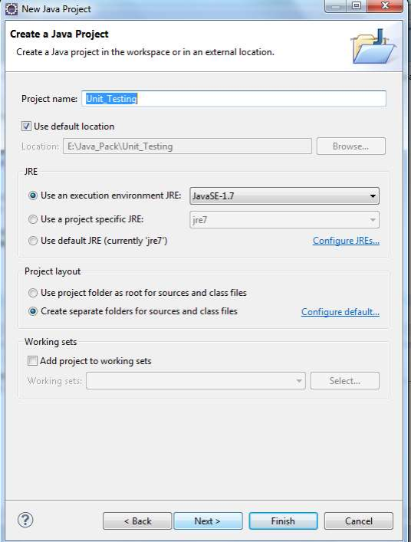
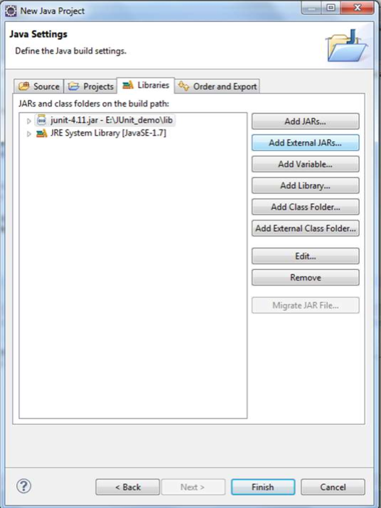

As step 2 Add the
downloaded junit jar
file and try to finish the
project creation
 | As step 1 Create a java project

Slide 20


JAR FILES USED IN THE MENTIONED SAMPLES

Slide 21
API'S OF JUNIT
Class Name | Functionality
Assert | A set of assert methods.
TestCase | A test case defines the fixture to run multiple tests.
TestResult | A TestResult collects the results of executing a test case.
TestSuite | A TestSuite is a Composite of Tests.

Slide 22

@TEST SAMPLE
package Test;
import static org.junit.Assert.*; import org.junit.Test;
import Test.Pet;
public class PetTest {
@Test
public void testPet() {
}
@Test
public void testMeaow()
{
Pet testPet = new Pet();
assertTrue("Meaow".equals(testPet.meaow()));
package Test;
public class Pet { public Pet() {}
public String meaow() { return "Meaow";
} }
} }

Slide 23
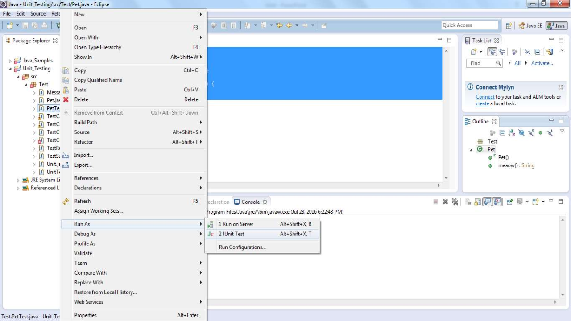

Slide 24
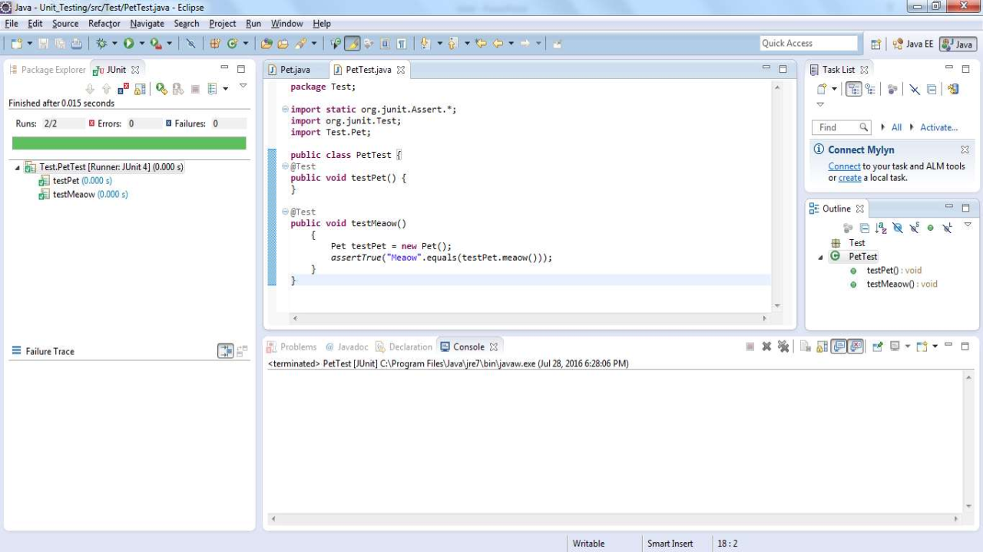

Slide 25
CREATE A JAVA CLASS & TEST CLASS
• Create a classTestSamples.java
public class TestSample {
public int multiply(int x, int y) {
return x * y;
package TestSamples;
}
}
• Right click onTestSamples.java, select New ->others-->(Inside JUnit folder)JUnit Test case and select Next button, the following window appears

Slide 26
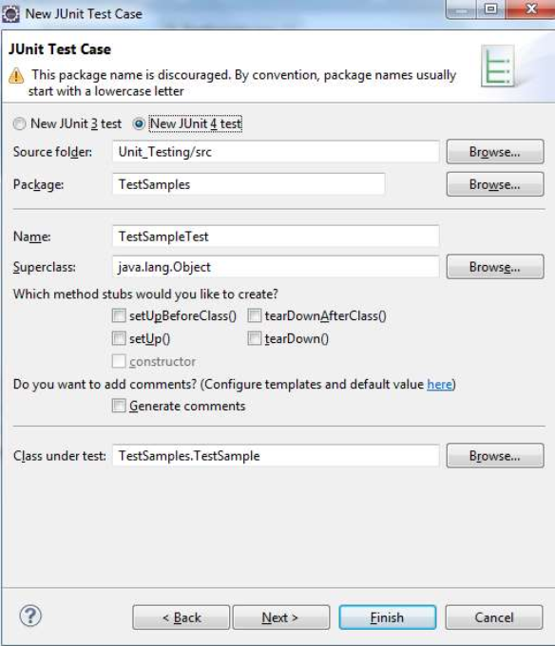
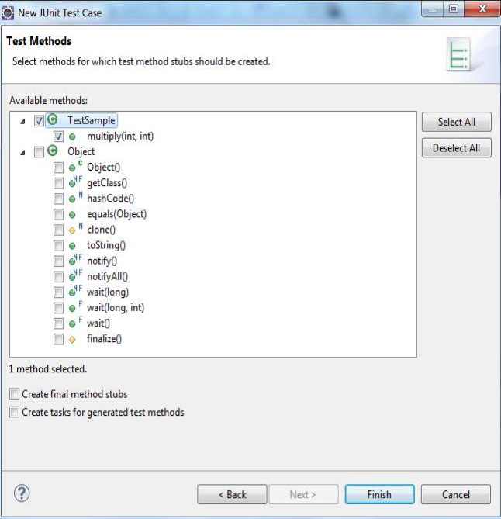


Select the check box
TestSample and click
Finish
Click Next

Slide 27
• On clicking finish a new file namedTestSampleTest.javagets created automatically and is as follows
package TestSamples;
import static org.junit.Assert.*;
import org.junit.Test;
public class TestSampleTest {
@Test
public void test() {
fail("Not yet implemented");
}
}
• Now edit the stub so as to make it assertive.

Slide 28
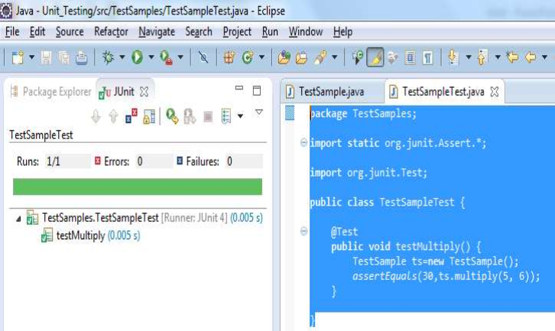
• After editing the stub, now the class file and its test case looks something like this
package TestSamples;
import static org.junit.Assert.*;
import org.junit.Test;
public class TestSampleTest {
@Test
public void testMultiply() { TestSample ts=new TestSample();
assertEquals(30,ts.multiply(5, 6));
}
}

Slide 29
EXECUTING A JUNIT TEST
• Right click on your new test class and select Run-As-> Junit Test.
• If the output shows green flag, your test is successful.
• If it shows red, it means class have some failures or errors.
• It will also show you the methods which has errors and the Failure Trace

Slide 30
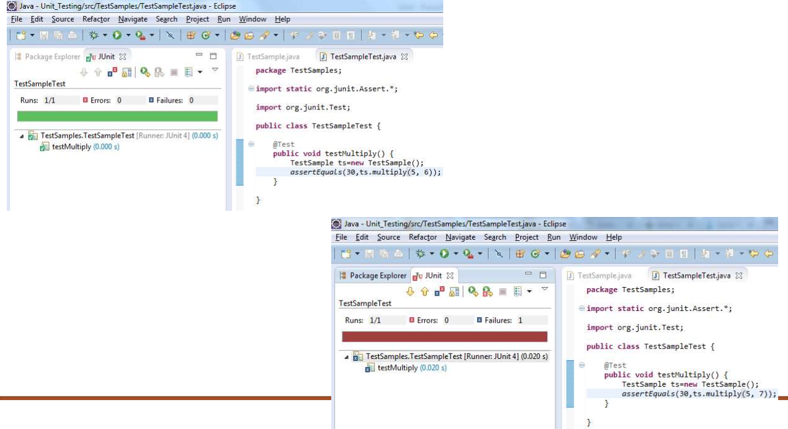
• Both failure and successful scenarios are displayed here for the same

Slide 31
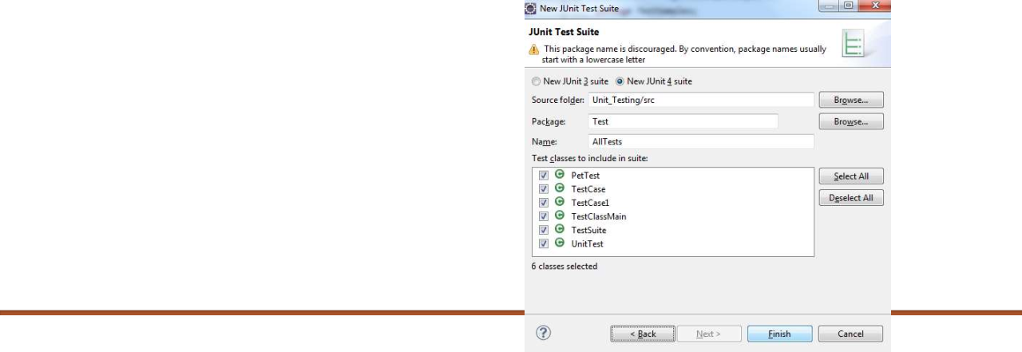
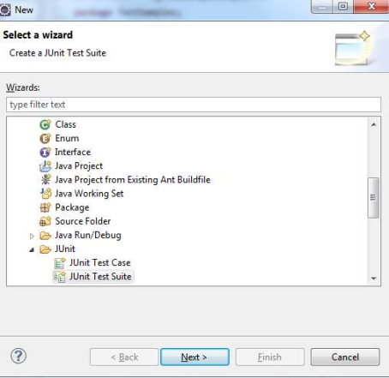
CREATING A TEST SUITE
• Multiple tests can be combined into a test suite. All test in this test suite will then be executed if you run the test suite.
• To create a new test suite, select your package, right mouse click->, select New->Others->Junit ->JUnit Test Suite->next->Finish.

Slide 32
CREATING A TEST SUITE(CONTD…)
• As a result the following TestSuite is created
package Test;
import org.junit.runner.RunWith; import org.junit.runners.Suite;
import org.junit.runners.Suite.SuiteClasses;
@RunWith(Suite.class)
@SuiteClasses({ PetTest.class, TestCase.class, TestCase1.class, TestClassMain.class, TestSuite.class, UnitTest.class })
public class AllTests {
}

Slide 33
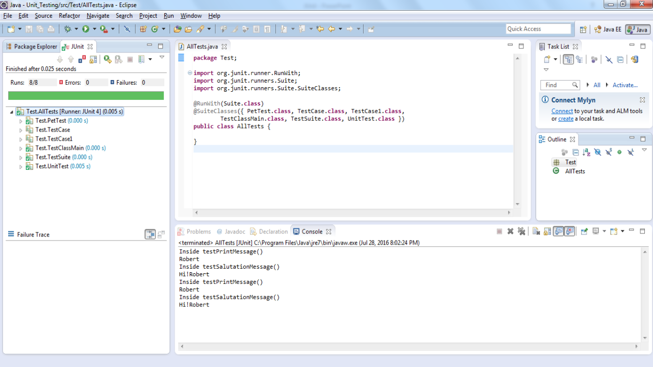

Slide 34
TESTCASE CLASS
• org.junit.TestCase class id declared as follows.
public abstract class TestCase extends Assert implements Test
• A test case defines the fixture to run multiple tests.

Slide 35
FREQUENTLY USED METHODS FROM TESTCASE CLASS
• int countTestCases() Counts the number of test cases.
• TestResult createResult() Creates a default TestResult object.
• String getName() Gets the name of a TestCase.
• TestResult run() A convenience method to run this test.
• void run(TestResult result) Runs the test case and collects the results in TestResult.
• void setName(String name) Sets the name of a TestCase.
• void setUp() Sets up the fixture, for example, open a database connection.
• void tearDown() Tears down the fixture, for example, close a database connection.
• String toString() Returns a string representation of the test case.

Slide 36
package TestSamples; import junit.framework.TestCase; | TESTCASE CLASS EXAMPLE
import org.junit.Before; import org.junit.Test;
public class TestJunit extends TestCase {
protected double fValue1; protected double fValue2;
@Before
public void setUp() {
System.out.println("setup"); fValue1= 8.0;
fValue2= 9.0; }
@Test
public void testCaseAdd() {
//count the number of test cases
System.out.println("No of Test Case = "+ this.countTestCases());
//test getName
String name= this.getName(); System.out.println("Test Case Name = "+ name);
//test setName
this.setName("testCaseAddNew"); String newName= this.getName();
System.out.println("Updated Test Case Name = "+ newName); assertEquals(5.0, fValue1+fValue2);
}}

Slide 37
package TestSamples;
import org.junit.runner.JUnitCore; import org.junit.runner.Result;
import org.junit.runner.notification.Failure;
public class Main {
public static void main(String[] args) {
Result result = JUnitCore.runClasses(TestJunit.class);
for (Failure failure : result.getFailures()) {
System.out.println(failure.toString()); } System.out.println(result.wasSuccessful());
} }
Output:
Test Case Name = testCaseAdd
Updated Test Case Name = testCaseAddNew testCaseAddNew(TestSamples.TestJunit): expected:<5.0> but was:<17.0> false
setup No of Test Case = 1

Slide 38
JUNIT TESTRESULT
• TestResult collects the results of executing a test case.
TestResult Class
• The declaration for org.junit.TestResult class:
public class TestResult extends Object
• A failure is anticipated and checked for with assertions.
• Errors are unanticipated problems such as ArrayIndexOutOfBoundsException.

Slide 39
FREQUENTLY USED METHODS FROM TESTRESULT CLASS.
• void addError(Test test, Throwable t) Adds an error to the list of errors.
• void addFailure(Test test, AssertionFailedError t) Adds a failure to the list of failures.
• void endTest(Test test) Informs the result that a test was completed.
• int errorCount() Gets the number of detected errors.
• Enumeration<TestFailure> errors() Returns an Enumeration for the errors.
• int failureCount() Gets the number of detected failures.
• void run(TestCase test) Runs a TestCase.
• int int runCount() Gets the number of run tests.
• void startTest(Test test) Informs the result that a test will be started.
• void stop() Marks that the test run should stop.

Slide 40
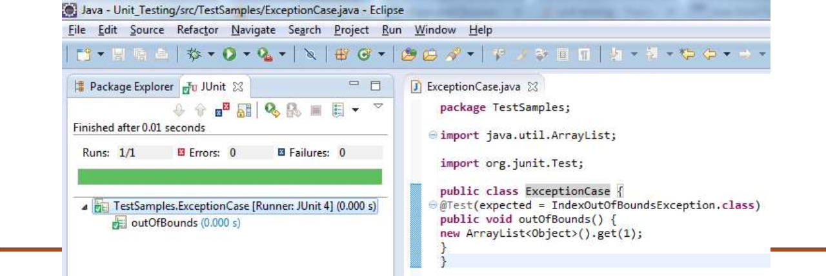
TESTING FOR EXCEPTIONS IN JUNIT
• The Test annotation supports 'expected' parameters which declares that a test method should throw an exception. If it doesn't throw an exception or if it throws a different exception than the one declared, the test fails.
• For example, the following test succeeds :

Slide 41

JUNIT ANNOTATION IMPLEMENTATION COMPLETE
EXAMPLE
• Junit Annotation Class : AnnotTest.java
• Test Runner Class : AnnotTestRunner.java
Source code and its out are displayed in the following slides

Slide 42
package Test;
import org.junit.After; import org.junit.AfterClass; import org.junit.Before; import org.junit.BeforeClass; import org.junit.Ignore; import org.junit.Test;
public class AnnotTest {
@BeforeClass
public static void beforeClass() {
System.out.println("in before class"); }
@AfterClass
public static void afterClass() {
System.out.println("in after class"); }
@Before
public void before() {
System.out.println("in before"); }
@After
public void after() {
System.out.println("in after"); }
@Test
public void test() {
System.out.println("in test"); }
@Ignore
public void ignoreTest() {
System.out.println("in ignore test"); }
}

Slide 43
package Test;
import org.junit.runner.JUnitCore; import org.junit.runner.Result;
import org.junit.runner.notification.Failure;
public class AnnotTestRunner {
public static void main(String[] args) {
Result result = JUnitCore.runClasses(AnnotTest.class);
for (Failure failure : result.getFailures()) {
System.out.println(failure.toString()); } System.out.println(result.wasSuccessful());
} }
Output:
in before class in before in test in after in after class true

Slide 44
ORGANIZING TEST FIXTURES WITH SETUP/TEARDOWN AND @BEFORE/ @AFTER
• JUnit test runners automatically invoke the setUp() method before running each test. This method typically initializes fields, turns on logging, resets environment variables, and so forth.
• JUnit test runners automatically invoke the tearDown() method after running each test which releases above mention resources after test.
• Annotating a public void method with @Before causes that method to be run before the Test method.
• Annotating a public void method with @After causes that method to be run after the Test method.
• Annotating a public static void method with @BeforeClass causes it to be run once before any of the test methods in the class.
• Annotating a public static void method with @AfterClass causes it to be run after all tests have finished.

Slide 45
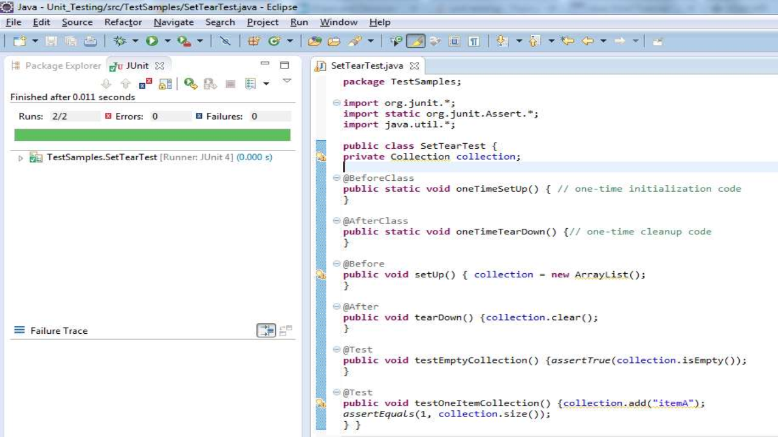

The methods will execute in the following order:
• oneTimeSetUp()
• setUp()
• testEmptyCollection()
• tearDown()
• setUp()
• testOneItemCollection()
• tearDown()
• OneTimeTearDown()

Slide 46
A COMPLETE EXAMPLE OF JUNIT TESTING
package Testing;
public class Student { private String name; private String city; private int age; private int percentage; }
• Pojo class :Student.java
• Business Logic :StudentDetails.java
• Test Case class :StudentDetailsTest.java
• Main Class :StudentMain.java
package Testing;
public class StudentDetails {
public String calculatePercentage(Student student){
String status;
if(student.getPercentage() < 50){
status = "Fail";
}else{
status = "Pass";
}
return status;
} }

Slide 47
package Testing;
import org.junit.Test;
import static org.junit.Assert.assertEquals;
public class StudentDetailsTest {
StudentDetails studentDetails =new StudentDetails();
Student student = new Student();
@Test
public void CalculatePercentage() {
student.setName("Derick"); student.setAge(25); student.setCity("Agra"); student.setPercentage(79);
String status=studentDetails.calculatePercentage(student);
assertEquals("Fail", status, "Fail");
} }

Slide 48
package Testing;
import org.junit.runner.JUnitCore; import org.junit.runner.Result;
import org.junit.runner.notification.Failure;
public class StudentMain {
public static void main(String[] args) {
Result result = JUnitCore.runClasses(StudentDetailsTest.class);
for (Failure failure : result.getFailures()) {
System.out.println(failure.toString()); } System.out.println(result.wasSuccessful());
} }

Slide 49
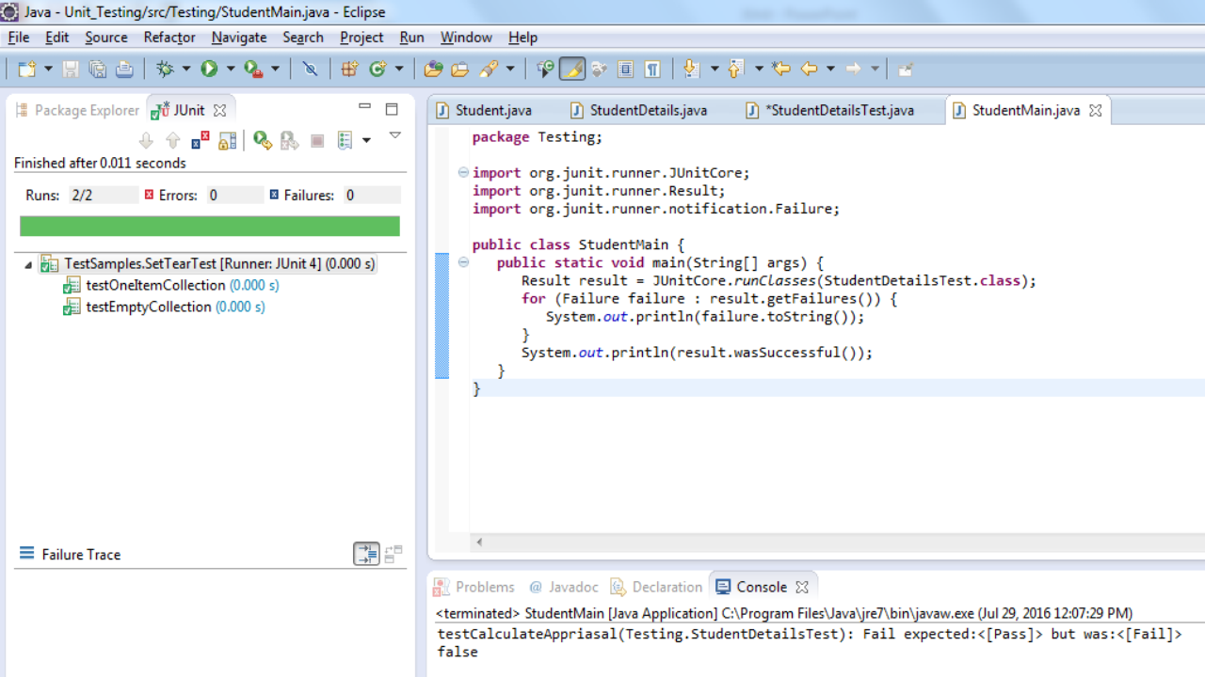

Slide 50
JUNIT TIME TEST
• Junit has a handy option of Timeout.
• If a test case takes more time than specified milliseconds then Junit will automatically mark it as failed.
• The timeout parameter is used along with @Test annotation.

Slide 51
package Test;
import static org.junit.Assert.*; import org.junit.Test;
import Test.Pet;
public class PetTest {
@Test
public void testPet() {
}
@Test (timeout=5000)
public void testMeaow()
{
Pet testPet = new Pet();
assertTrue("Meaow".equals(testPet.meaow()));
package Test;
import org.junit.runner.JUnitCore; import org.junit.runner.Result;
import org.junit.runner.notification.Failure;
public class AnnotTestRunner {
public static void main(String[] args) {
Result result = JUnitCore.runClasses(PetTest.class);
for (Failure failure : result.getFailures()) {
System.out.println(failure.toString()); }
System.out.println(result.wasSuccessful()); }
}
} }
Output: true

Slide 52

THANK YOU…

